Slide 1
Comic Design Webpage Using Flask
E.Yasaswini

Slide 2
About Us
This is a simple webpage for searching for comics.
This is mainly searching for comic stories and videos.
By using the Flask framework we created this webpage.
Flask is one type of framework in Python is mainly used for scaler web applications.

Slide 3
Home Page
In the Home page it contain all comic story posts.
By clicking that story post it will redirect to another page.
On that page contains all seasons and episodes of the comics.
I am attaching the Home page screen short for our reference.

Slide 4
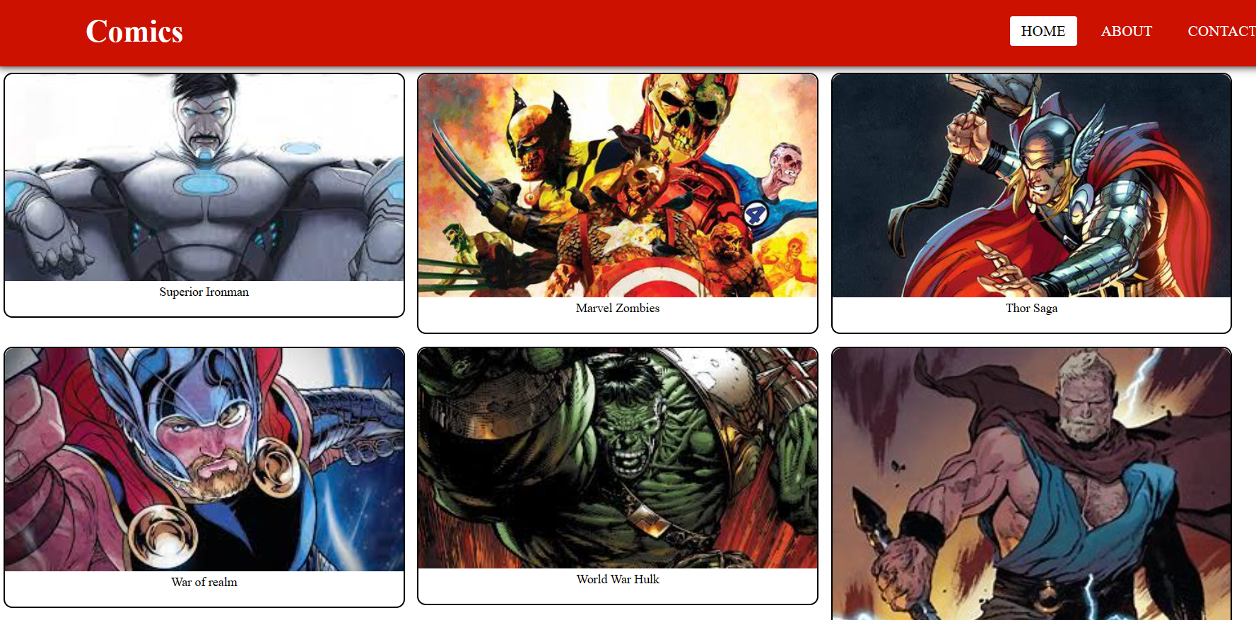

Slide 5
Contact US
In the Contact us page contains some fields like Name email id and user query.
By Submitting the user query we can solve the user query.

Slide 6
Thank you
E.Yasaswini

